Slide 1



Time Series Classification with the aeon toolkit
Tony Bagnall
A.J.Bagnall@soton.ac.uk
School of Electronics and Computer Science
University of Southampton

Slide 2
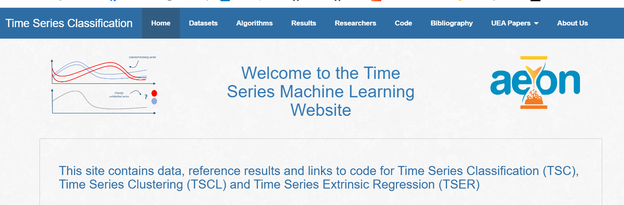

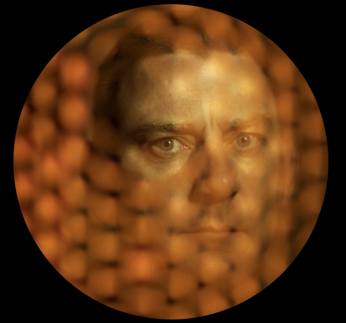

Time Series Machine Learning Repository
www.timeseriesclassification.com
UCR Univariate Time Series Classification Archive 2002-
More on archives at the end of the tutorial
UEA Multivariate Time Series Univariate Classification Archive 2017-

Slide 3
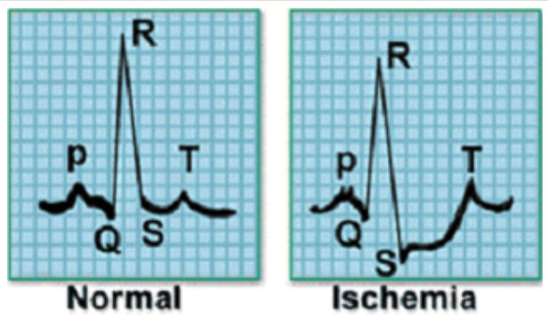
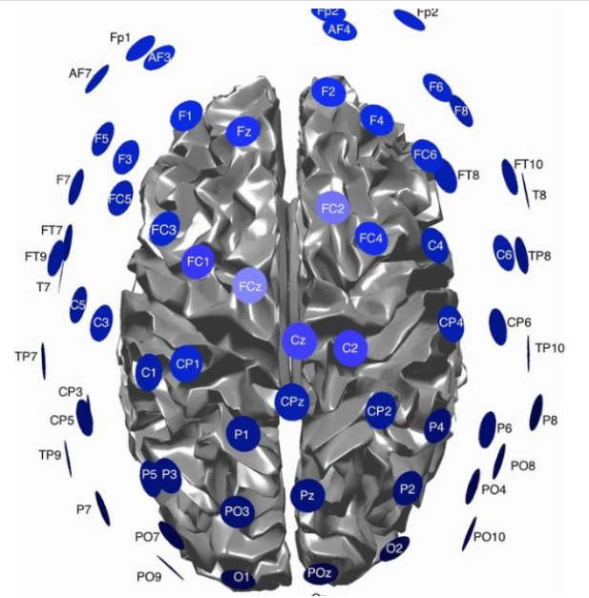
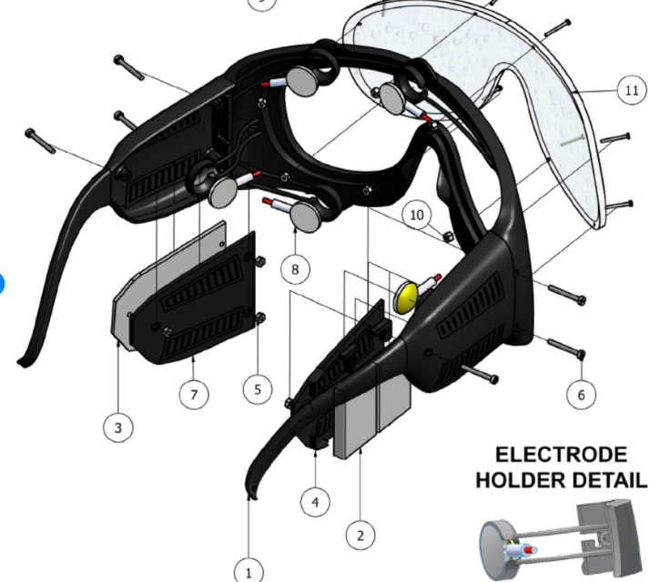
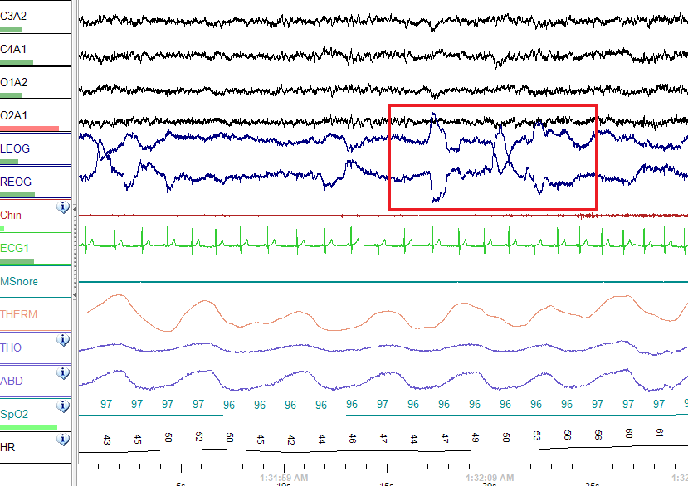
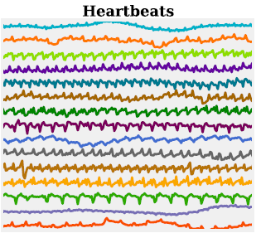
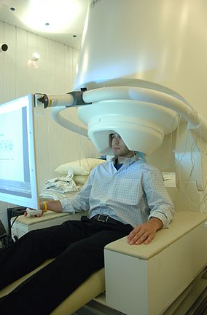
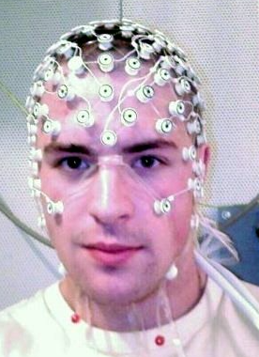
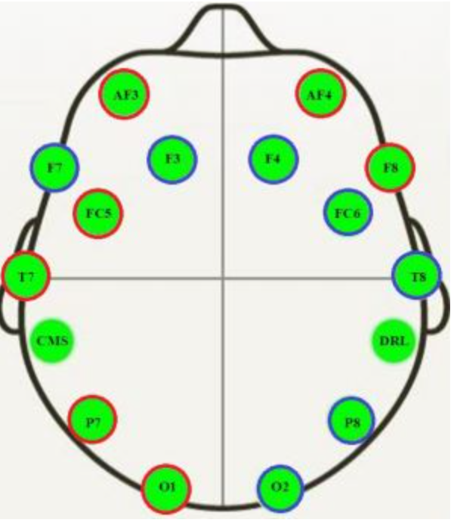
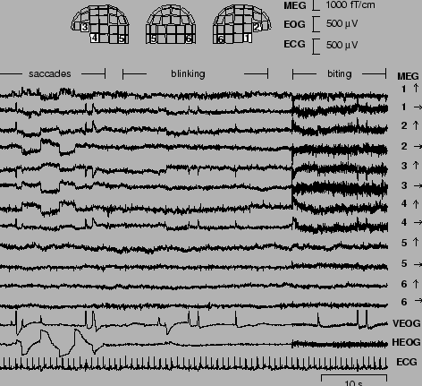
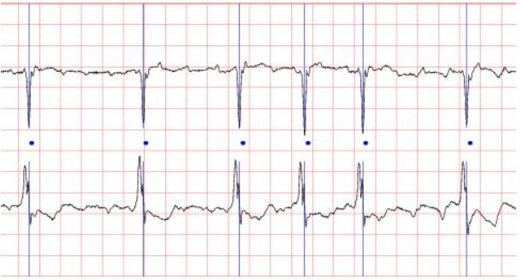
Biomedical signals
ECG, EEG, MEG, EOG
Notes:
Here are a few examples of classes in the MPEG7 dataset, we’re going to construct an example problem of some ordered data.

Slide 4
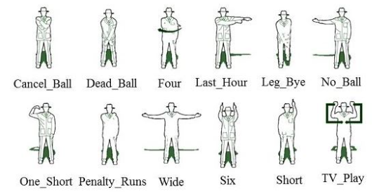
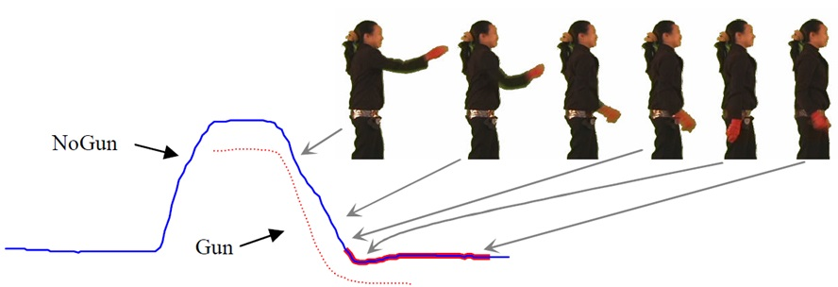
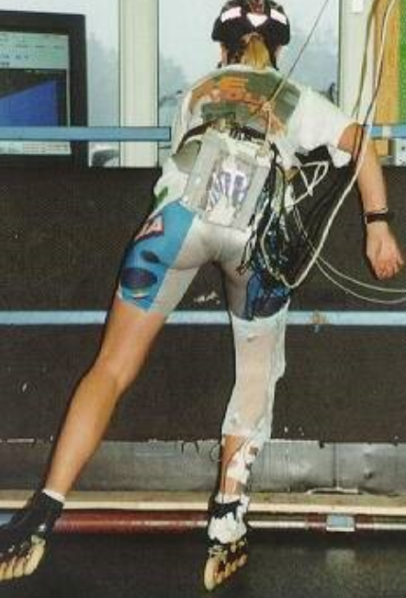
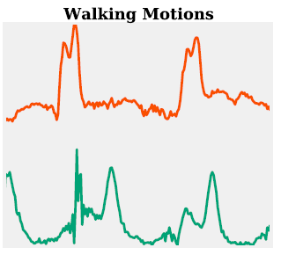
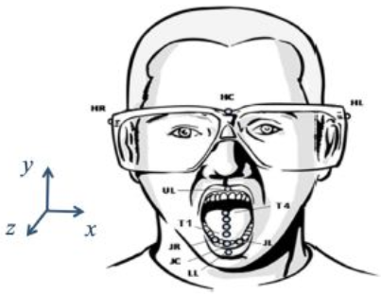
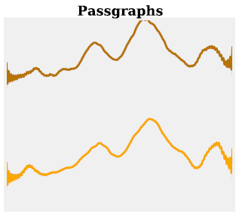
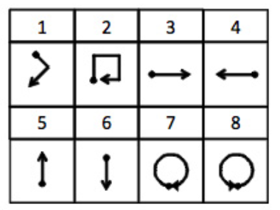
Human Activity Recognition
Gestures (Uwave), Cricket hand signals, Gun Point, Asphalt road condition, inline skating
Notes:
Here are a few examples of classes in the MPEG7 dataset, we’re going to construct an example problem of some ordered data.

Slide 5
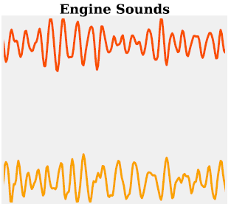
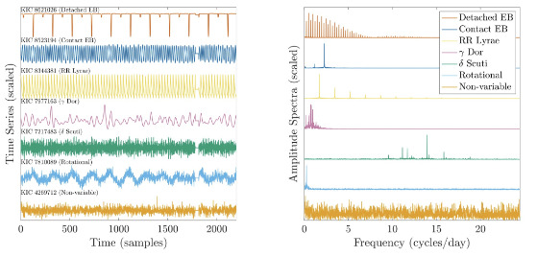
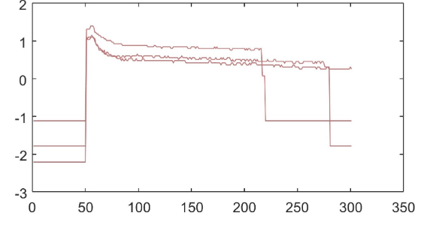
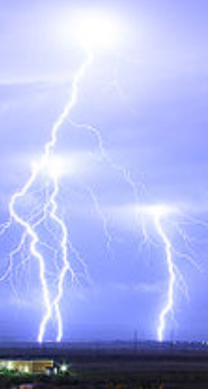
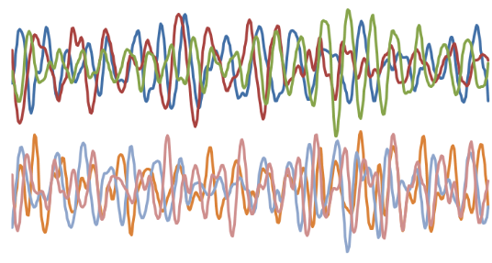
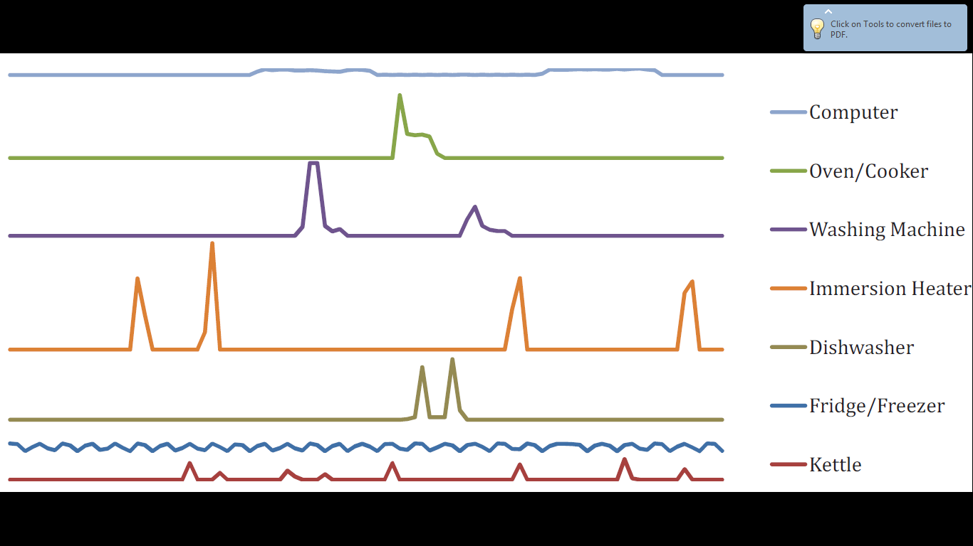
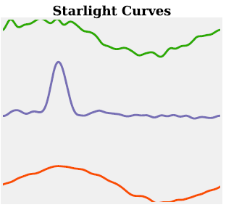
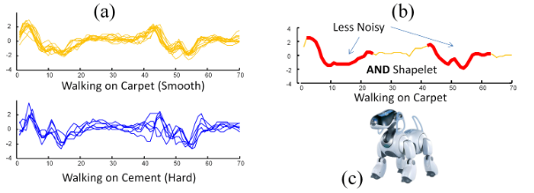
Sensor Data
Car engines, light curves, lightning, electric devices
Insect wing beats, Car Engines, Phonemes (sound), Worm Motion
Notes:
Here are a few examples of classes in the MPEG7 dataset, we’re going to construct an example problem of some ordered data.

Slide 6
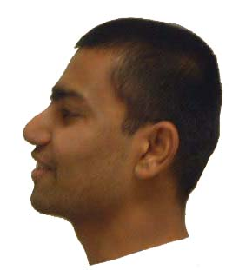
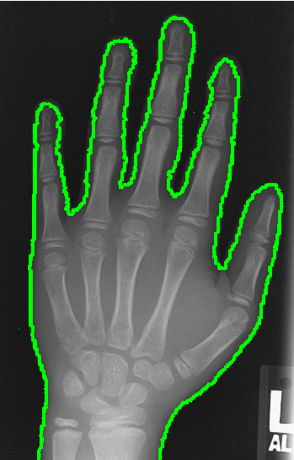
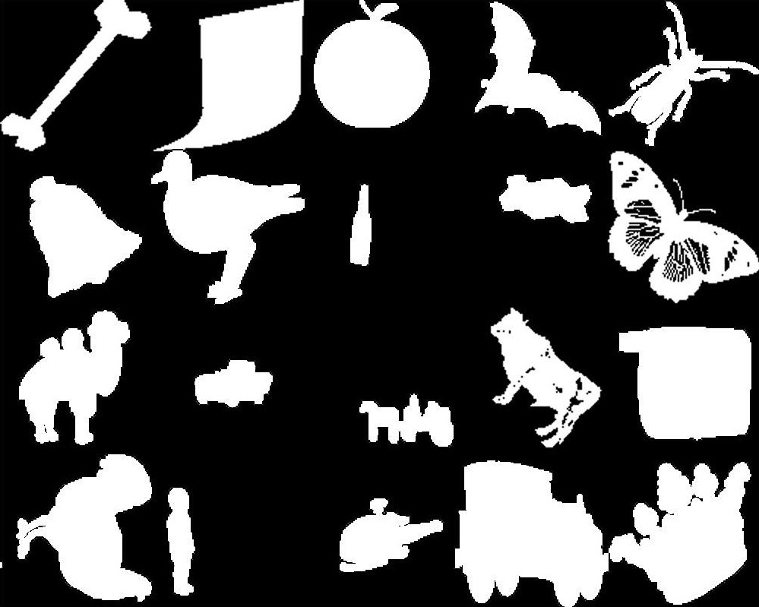
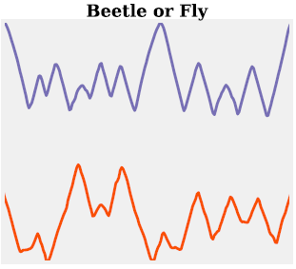

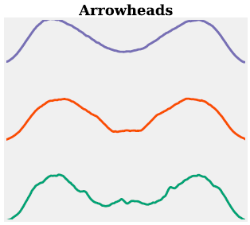
Image Outlines
Hand and bone outlines, Herring Otoliths, Faces, Leaves, Arrow Heads, Yoga, Words/letter, Shapes (MPEG7)
Hand and bone outlines, Herring Otoliths, Faces, Leaves, Arrow Heads, Yoga, Words/letter, Shapes (MPEG7)
1
0.5
0
0
50
100
150
200
250
300
350
400
450
Notes:
Here are a few examples of classes in the MPEG7 dataset, we’re going to construct an example problem of some ordered data.

Slide 7
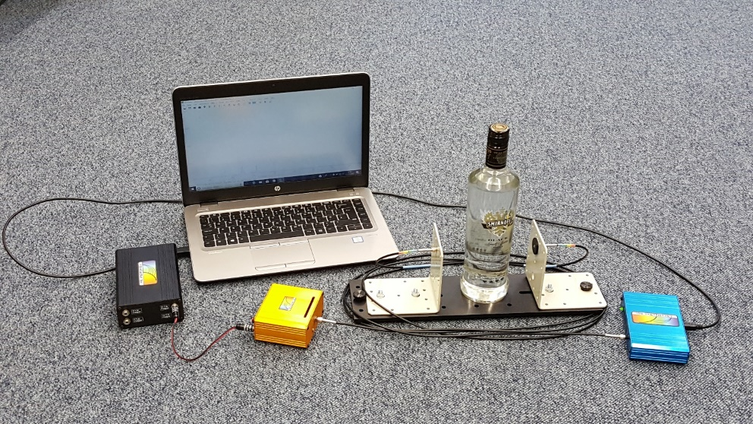

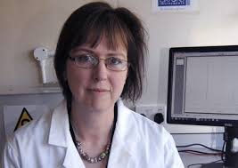
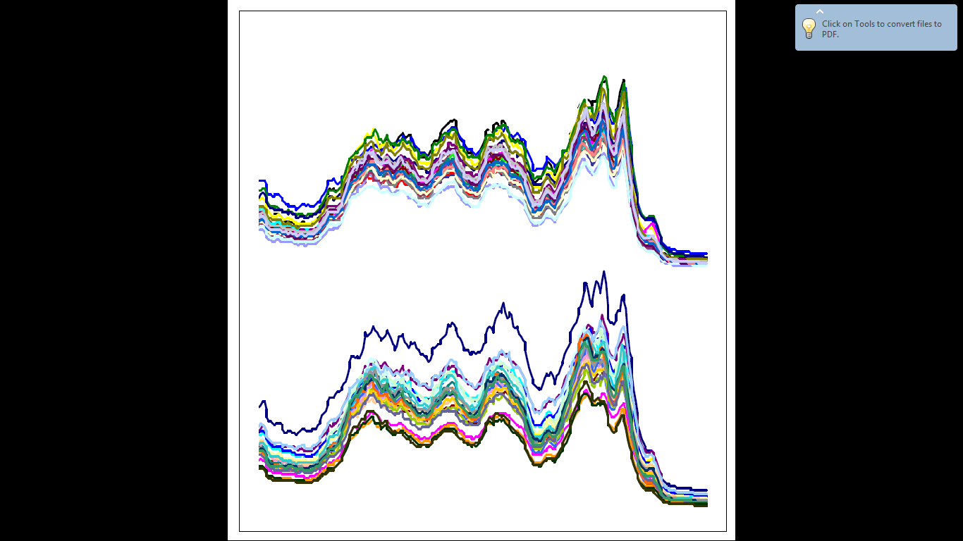
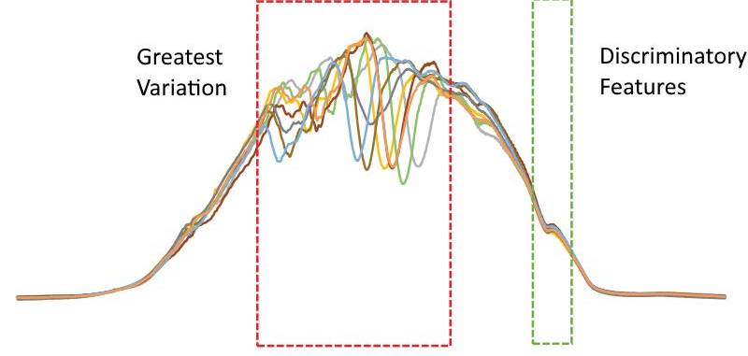
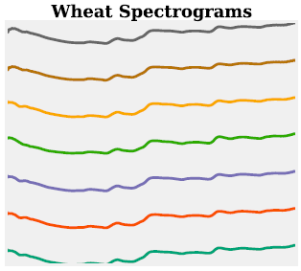
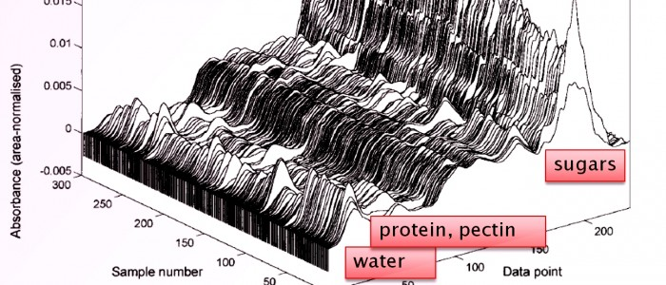
Food Spectrographs
Beef, Coffee, Ham, Meat, Olive Oil, Strawberry, Wine, Whisky
Notes:
Here are a few examples of classes in the MPEG7 dataset, we’re going to construct an example problem of some ordered data.

Slide 8
Time Series Classification (TSC)
Labelled training series
Classify unlabelled series
?
Notes:
We consider a time series to be any real-valued ordered data, typically recorded in temporal order at fixed intervals of time.
This doesn’t necessarily need to be time series data, just any ordered data, for example image outlines can be formatted as a 1D signal.
Many data mining problems can be formed with time series data, we specifically focus on time series classification, or TSC problems for short.

Slide 9
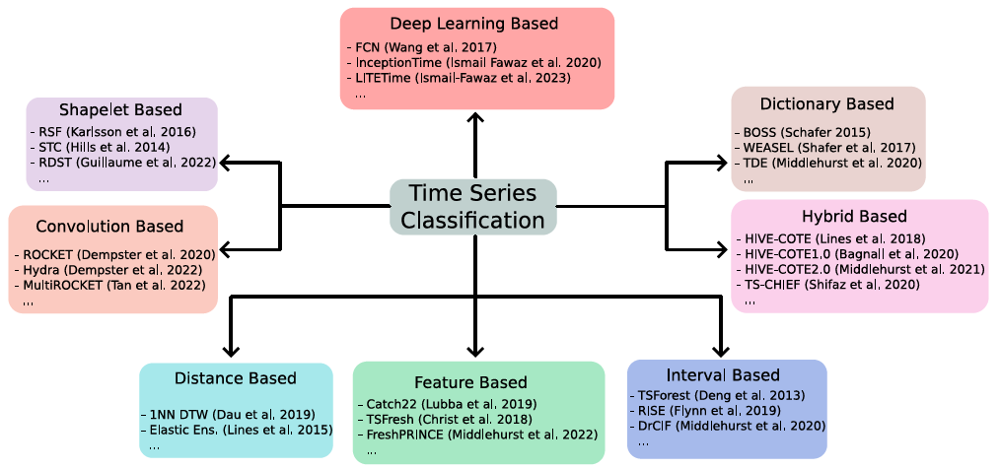
A Taxonomy of Algorithms
TSC

Slide 10
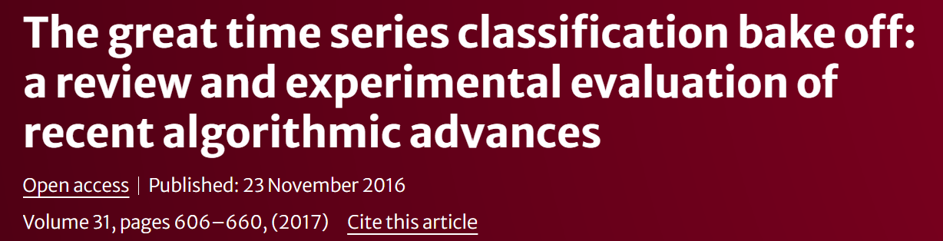

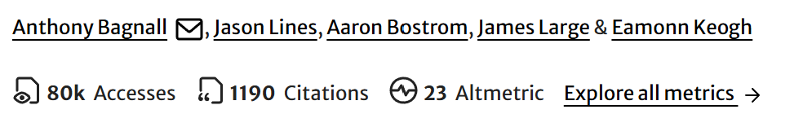
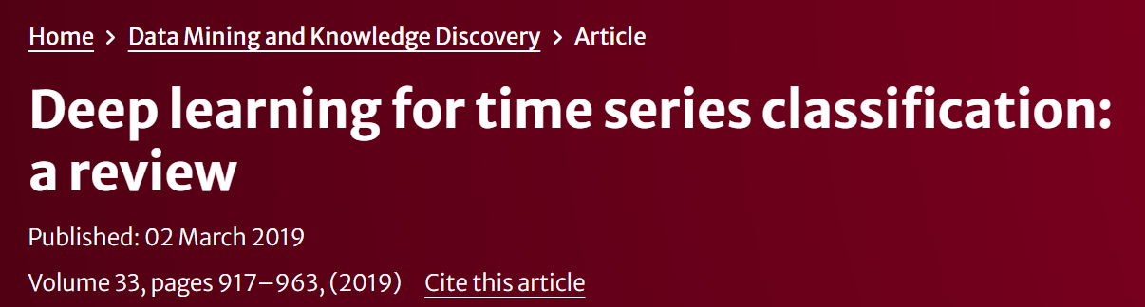
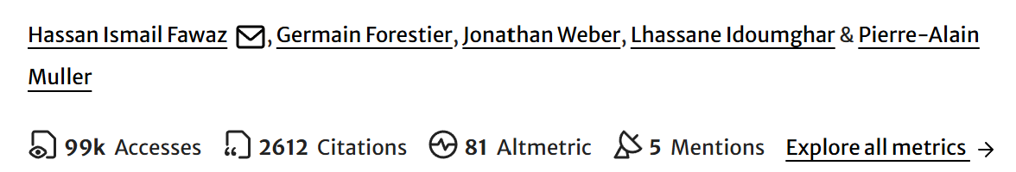

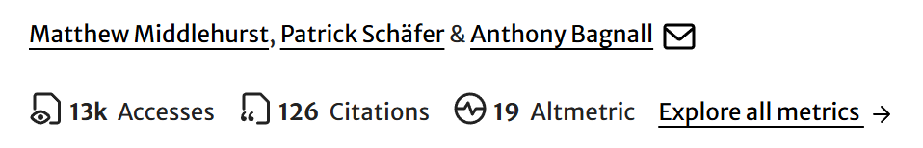

Slide 11
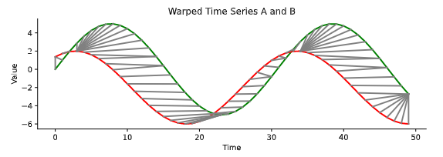
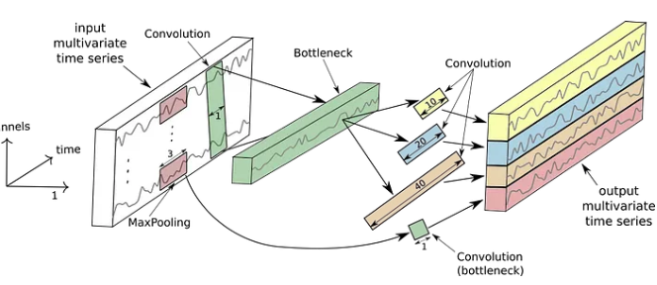
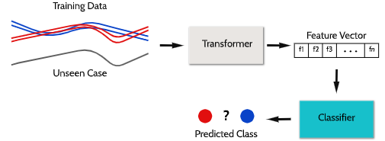
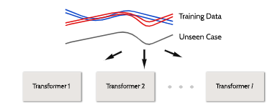
Taxonomy of Time Series Classification Algorithms Part I
Distance based
Deep learning
Feature based
Interval based

Slide 13
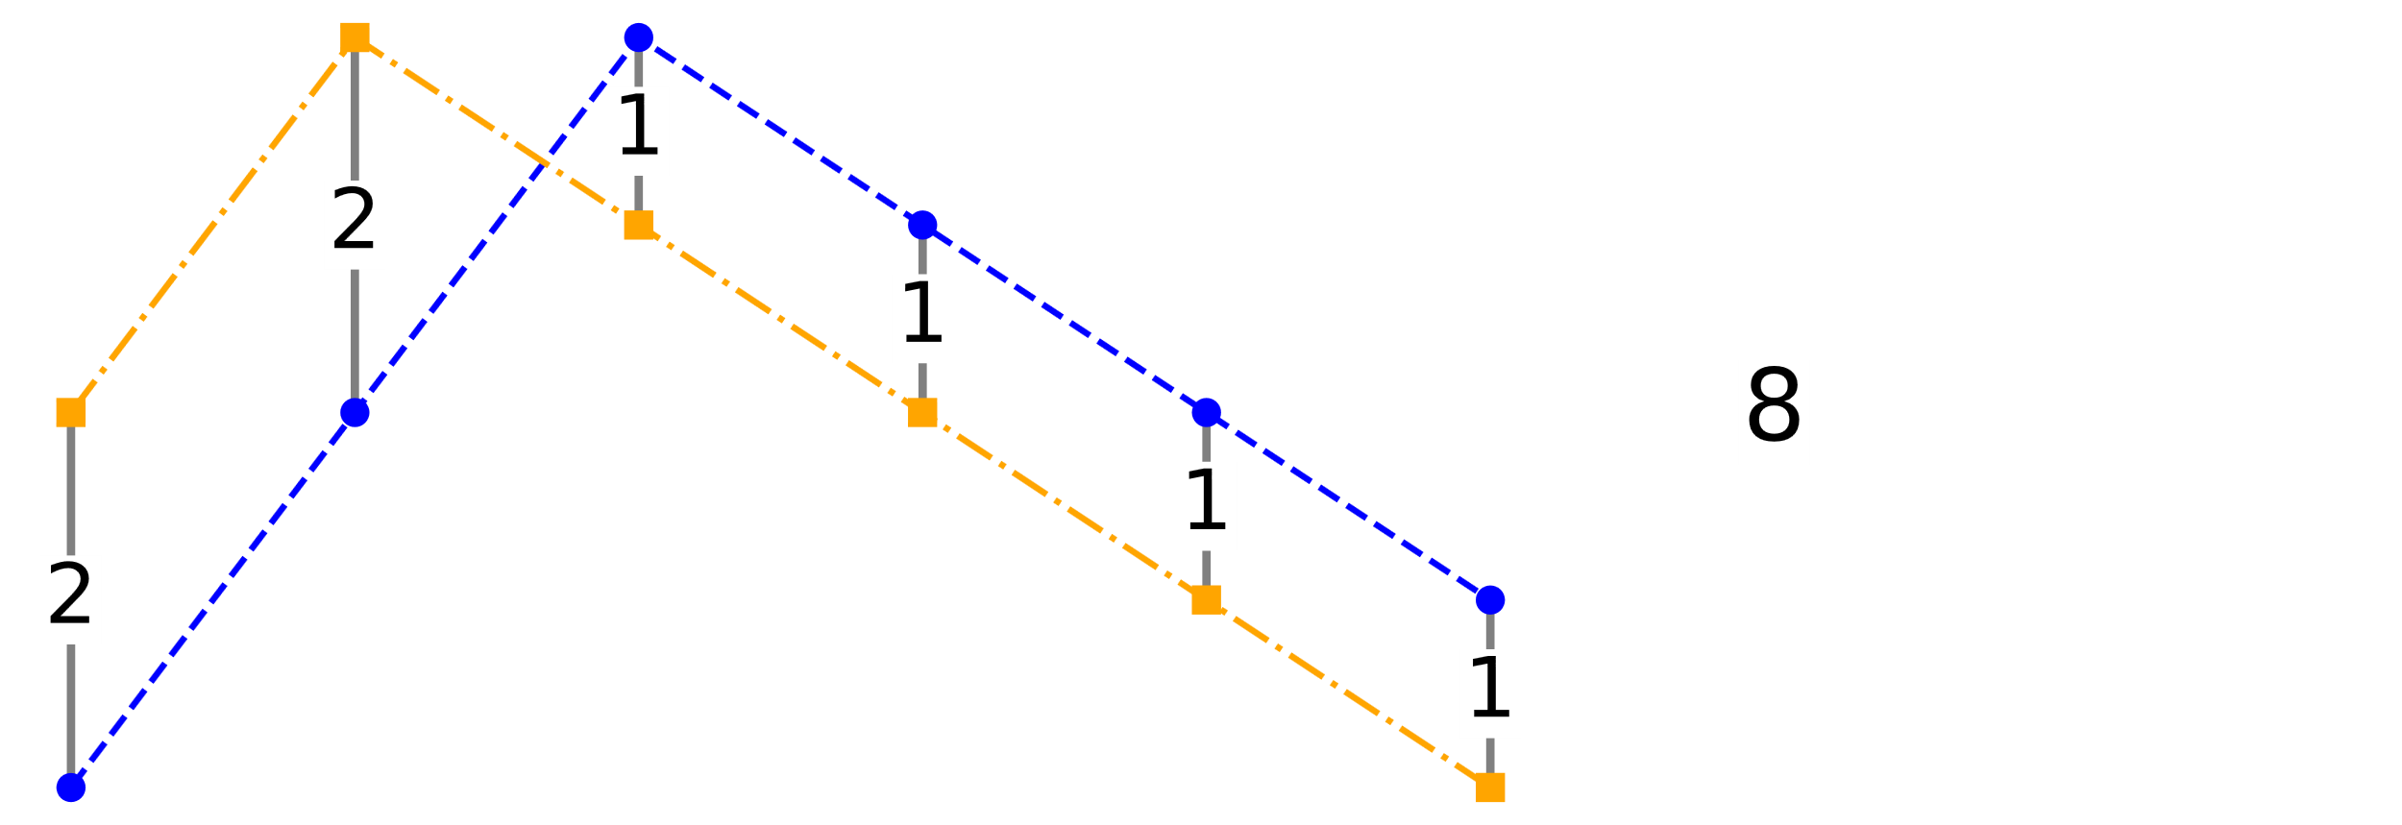
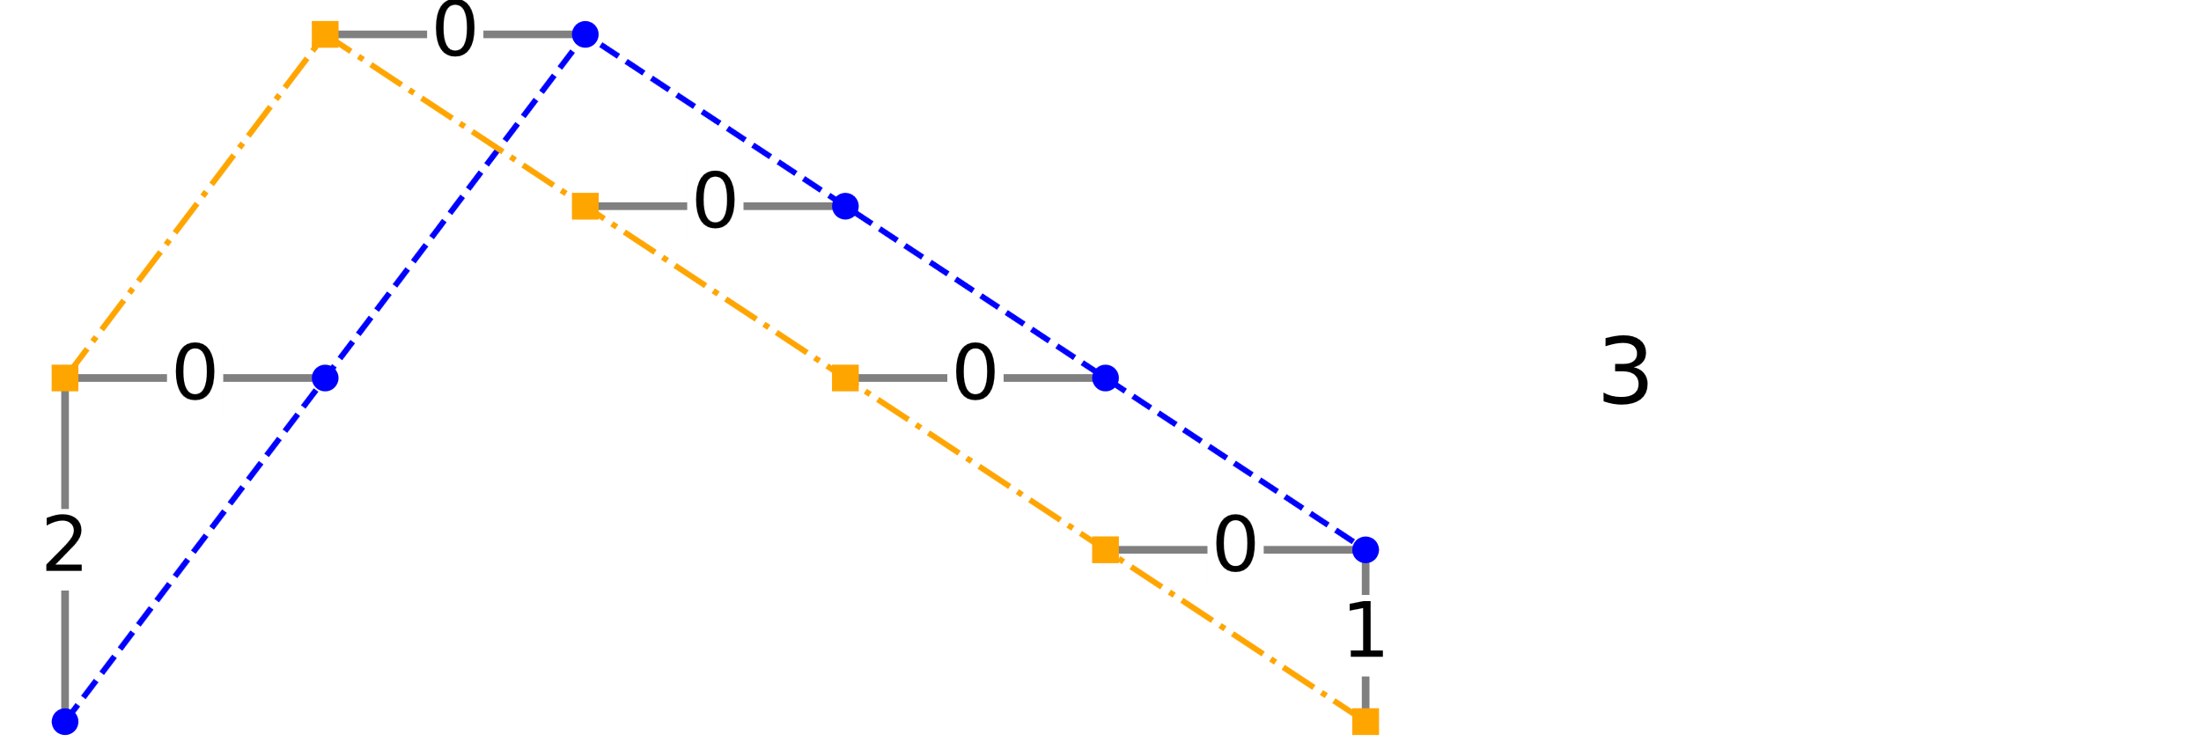
Distance Based Classifiers
Some of the earliest TSC approaches assessed similarity of series through measures of distance using a nearest neighbour estimator.
Distances are used throughout time series machine learning; we will not cover them in detail here.
Direct distances
(Euclidean distance)
Elastic distances
(Dynamic time warping)

Slide 14




Distance Based Classifiers
DTW has no explicit penalty for moving off the diagonal.
More on distances tomorrow when we cover clustering

Slide 15

Elastic Ensemble (EE)
Euclidean Distance
DTW (full)
DTW (cv window)
Derivative DTW (full)
Derivative DTW (cv window)
Weighted DTW
Weighted Derivative DTW
Longest Common Subsequence
Edit Distance with Real Penalty
Move-Split-Merge
Time-warp Edit Distance
The Elastic Ensemble
Simple and transparent proportional voting scheme
Constituents weighted by training cross-validation accuracy
First reported TSC algorithm to significantly outperform DTW on the UCR datasets

Slide 16







Best in class: Proximity Forest (PF)
BUT ….
We currently only have PF in aeon, not yet PF2

Slide 17
Feature Based Pipelines

Slide 18
Time Series Feature Extraction
Max
10
10
8
8
Max | Min | … | Mean | Class
10 | 3 | … | 5 | Blue
8 | 2 | … | 4 | Blue
10 | 2 | … | 5 | Red
8 | 1 | … | 4 | Red

Slide 19







Feature Based Pipelines
The simplest transformation based approach is to create summary features then use a standard classifier
There are many toolkits that create summary features

Slide 20

Summary Statistic Collections
Highly Comparative Time-Series Analysis (hctsa)
Over 7700 features.
Implemented in MATLAB.
https://github.com/benfulcher/hctsa
CAnonical Time-series Characteristics (Catch22)
22 features.
Implemented in C. Subset of hctsa. https://github.com/chlubba/catch22
Time Series Feature extraction based on scalable hypothesis tests (TSFresh)
Just under 800 features.
Implemented in Python.
https://github.com/blue-yonder/tsfresh

Slide 21

Canonical Time-series Characteristics (catch22)
7658 features filtered down to 22 using a 3 step process:
1. Remove features that perform worse than random chance
2. Sort by balanced accuracy, remove using a threshold
3. Cluster remaining features, select a feature from each cluster for accuracy, speed and interpretability
Figure of the catch22 filtering process from: Lubba, Carl H., et al. "catch22: CAnonical Time-series CHaracteristics." Data Mining and Knowledge Discovery 33.6 (2019): 1821-1852.
Notes:
The Canonical Time-series Characteristics, or catch22, is a set of 22 informative and low redundancy features extracted from the 7000 plus features in the Highly Comparative Time Series Analysis toolbox.
A three step process shown here was used to select the most important features.
The feature set built on the whole series was shown previously performing significantly worse than TSF, we integrate it into the interval structure to great effect however.
The catch22 features are more computationally expensive than the mean, standard deviation and slope but we deemed the cost worth it.

Slide 22
Examples of Complex Summary Statistic
SB_BinaryStats_mean_longstretch1 - Longest period of consecutive values above the mean.
Linear_trend_timewise - Calculate a linear least-squares regression for the values of the time series versus the sequence from 0 to length of the time series minus one.
SP_Summaries_welch_rect_area_5_1 - Total power in lowest fifth of frequencies in the Fourier power spectrum.
Matrix_profile_mean – Calculate the 1-D matrix profile and return the mean of it.

Slide 23


aeon feature based transformers
https://www.aeon-toolkit.org/en/stable/examples.html

Slide 24

Using Transformers
import numpy as np from aeon.transformations.collection.feature_based import TSFreshFeatureExtractor, \ Catch22, TSFreshRelevantFeatureExtractor, SevenNumberSummaryTransformer # 50 univariate time series with and 300 time points X = np.random.random((50, 1, 300)) ts_fresh = TSFreshFeatureExtractor() c22 = Catch22() stats = SevenNumberSummaryTransformer() catch22 = Catch22() X2 = ts_fresh.fit_transform(X) X3 = c22.fit_transform(X) X4 = stats.fit_transform(X) print(X2.shape) print(X3.shape) print(X4.shape)
We store collections of time series in numpy arrays shape
(n_cases,n_channels,n_timepoints)

Slide 25

Classification pipelines
You can use these transformers with an sklearn pipeline and sklearn classifier
from sklearn.pipeline import make_pipeline from sklearn.ensemble import RandomForestClassifier from sklearn.metrics import accuracy_score from aeon.datasets import load_italy_power_demand pipe= make_pipeline(TSFreshFeatureExtractor(), RandomForestClassifier()) trainX, trainy= load_italy_power_demand(split="train") testX, testy= load_italy_power_demand(split="test") pipe.fit(trainX, trainy) pred = pipe.predict(testX) print("accuracy =",accuracy_score(testy, pred))

Slide 26

Compared six different transformers with three different classifiers on the 112 UCR data
Transformers: Summary, PCA, Signature, RandomInterval, Catch22, TSFresh
Classifiers:
Rotation Forest (RotF) – Base classifier of STC, generally good with numeric data.
Cross-validated Ridge Regression (RidgeCV) – commonly used base classifier.
XGBoost – popular in certain domains
Best performing was
from aeon.transformations.collection.feature_based import TSFreshFeatureExtractor from aeon.classification.sklearn import RotationForestClassifier pipe = make_pipeline(TSFreshFeatureExtractor(), RotationForestClassifier())

Slide 27







Best in class: FreshPRINCE
The FreshPRINCE is a pipeline classifier combining TSFresh and the RotationForest classifier (FreshPRINCE).
BUT ….

Slide 28


Interval Based Ensembles
Features measured over the whole series can get confounded by noise in irrelevant sections

Slide 29

Time Series Forest (TSF): Deng et al. 2013
The first interval based classifier based on random forest tree ensemble.
For each member of the ensemble:
Randomly select k intervals that apply to each time series
Find three summary statistics (mean, deviation and slope) for each interval and concatenate
Train a simple decision tree
Each tree has a different set of random intervals

Slide 30


Diverse Representation Canonical Interval Forest (DrCIF) 2021

Slide 31
Random Supervised Time Series Forest (R-STSF) 2024
Key features:
Extracts intervals using a supervised process
Extracts 9 simple summary statistics
Uses a periodogram, first order differences and autoregressive series representation
0.55
0.7
0.9
0.6
0.6
0.8
Cabello, N., Naghizade, E., Qi, J. and Kulik, L., 2024. Fast, accurate and explainable time series classification through randomization. Data Mining and Knowledge Discovery, 38(2), pp.748-811.

Slide 32


QUANT (2024)
Key features:
Extracts fixed dyadic intervals
Uses the quantiles of intervals as features
Uses extremely randomised trees as a base classifer
Dempster, A., Schmidt, D.F. and Webb, G.I., 2024. Quant: A minimalist interval method for time series classification. Data Mining and Knowledge Discovery, pp.1-26.

Slide 33


Comparison

Slide 34





Part II: Time Series Classification
Shapelet based
Convolution based
Dictionary based
Hybrids

Slide 35






Shapelet-based Algorithms
Shapelets are discriminatory phase independent subseries
Camel or Chicken?
Shapelets are taken from the train data
Shapelets are taken from the training data

Slide 36



Shapelet Based Classifiers
Shapelets are discriminatory phase independent subseries taken from the train data
STC is a pipeline: select a set of shapelets, transform into distance to shapelet then build standard classifier

Slide 37
Using Shapelets
Classify based on distance between shapelets and series
Non invasive fetal heartbeat data
shapelet extracted
from series
Class 32: Bad Match
Class 28: OK Match
Class 27: Good Match

Slide 38
Shapelet Transform Classifier
Transform using k shapelets into a vector of distances to shapelets
Key Issues
How to select shapelets?
How to measure the distance between a shapelet and a single series?
How to measure shapelet quality?
What classifier to use?
Rotation Forest Classifier

Slide 39


Visualising Shapelets https://www.aeon-toolkit.org/en/stable/examples/classification/shapelet_based.html
"""Shapelet based time series classifiers.""" __all__ = [ "MrSQMClassifier", "ShapeletTransformClassifier", "RDSTClassifier", "SASTClassifier", "RSASTClassifier", "LearningShapeletClassifier", ]

Slide 40




Best in class: RDST
Inspired by ROCKET, RDST employs dilation to improve performance.

Slide 41

Convolution Based Pipelines

Slide 42


Convolution/kernel based:ROCKET
Geoff Webb’s group in Monash proposed a simple approach to TSC that does surprisingly well
Create a large number of random convolutions
Create feature vectors by pooling operations
Fit a linear classifier

Slide 43







ROCKET transform
For each kernel…
1. Window through series
2. Apply Kernel to each window
3. Extract max and PPV for all windows
Max 1
PPV 1
Max 2
PPV 2
…
Max k
PPV k
Max
PPV
The terms kernel and convolution are used interchangably
It is used in the same way as a deep learning convolution, but it is not learnt. It is random
It is also similar to a shapelet, but it is not from the training data.
This is called the activation map in deep learning
This is called the pooling operation in deep learning
Shapelet operation is like max pooling, but shapelets use Euclidean distance instead of dot product, and minimise
PPV is percentage of positive values

Slide 44


ROCKET
The ROCKET classifier applies thousands of randomly generated kernels (length, weights, bias, dilation, and padding) and builds a linear classifier with the pooled output.
}
linear classifier
Dempster, A., Petitjean, F. and Webb, G.I., 2020. ROCKET: exceptionally fast and accurate time series classification using random convolutional kernels. Data Mining and Knowledge Discovery, 34(5), pp.1454-1495.

Slide 45

ROCKET Variants
MiniRocket
MultiRocket
Random → fixed kernels
10,000 → 84 kernels (per dilation)
PPV only
Highly optimised (much faster than Rocket)
MiniRocket plus additional pooling operators (plus 1st order differences)
Rocket and MiniRocket “miss”: the magnitude of the response, the location of the response, the most prominent single response
MultiRocket uses PPV plus:
MPV: mean of positive values
MIPV: mean indices of positive values
LSPV: longest stretch of positive values
Similar speed to MiniRocket, significantly more accurate (on average)
Dempster, A., Schmidt, D.F. and Webb, G.I., 2021, August. Minirocket: A very fast (almost) deterministic transform for time series classification. In Proceedings of the 27th ACM SIGKDD conference on knowledge discovery & data mining (pp. 248-257).
Tan, C.W., Dempster, A., Bergmeir, C. and Webb, G.I., 2022. MultiRocket: multiple pooling operators and transformations for fast and effective time series classification. Data Mining and Knowledge Discovery, 36(5), pp.1623-1646.

Slide 46


ROCKET Variants
Hydra
Combine Rocket + dictionary methods
Dictionary methods: count symbolic patterns
Hydra: count random patterns (represented by random convolutional kernels)
Organise kernels into “groups”
Count the kernel in each group with the max output at each timepoint
I.e., “competing” convolutional kernels
Combine with MultiRocket (“MultiRocket+Hydra”)
Dempster, A., Schmidt, D.F. and Webb, G.I., 2023. Hydra: Competing convolutional kernels for fast and accurate time series classification. Data Mining and Knowledge Discovery, 37(5), pp.1779-1805.

Slide 47




Best in class: Multi-Rocket-Hydra

Slide 48

Dictionary Based Ensembles
Class 1
Class 2

Slide 49

Dictionary-based Algorithms
Dictionary methods based on the bag-of-words model
While shapelets look for the presence of a pattern, dictionary methods look for pattern repetition.

Slide 50



SAX Transform

Slide 51


SFA Transform
Schäfer, P. and Högqvist, M., 2012, March. SFA: a symbolic fourier approximation and index for similarity search in high dimensional datasets. In Proceedings of the 15th international conference on extending database technology (pp. 516-527).

Slide 52

Bag of SFA Symbols
BOSS form an ensemble of 1NN classifiers using parameterised SFA transforms.
Performance of individual models can be sensitive to the word length and size of the sliding window, so poorly performing estimators are filtered out.
Schäfer, P., 2015. The BOSS is concerned with time series classification in the presence of noise. Data Mining and Knowledge Discovery, 29, pp.1505-1530.

Slide 53



Dictionary Based Classifiers
Classifiers built on histograms have historically been either nearest neighbour classifiers or linear classifiers

Slide 54




Best in class: WEASEL 2

Slide 55

Dilated Sliding Window
0 | 1 | 3 | 2 | 9 | 1 | 14 | 15
Time Series T
Sliding window with dilation=2
Shifted along T
Example: d = 2 inserts gap of 1, down-samples by 2, doubles size of the receptive field
1st window
0 |  | 3 |  | 9
2nd window
1 |  | 2 |  | 1
3 |  | 9 |  | 14
3rd window
...
Rocket (convolution based)
RDST (shapelet based)
WEASEL (dictionary based)
Improves:

Slide 56

Hybrids: Combine Approaches
Meta ensembles explicitly combine classifiers built on different representations
Decision trees embed different representations internally at nodes

Slide 57




Slide 58




HIVE-COTE 1.0 (HC1)
Notes:
The classifier we focus on and aim to improve is version 1 of the Hierarchical Vote Collective of Transformation-based Ensembles, which I will now keep referring to as HIVE-COTE 1 and 2 respectively.
HIVE-COTE 1 contains four distinct classifiers, each extracting different types of features. The CAWPE ensemble structure is used, classifying using weighted probabilities from the components.
Previously we separated algorithms using their structure, we can also do this using the features they look to extract from the series.

Slide 59


HIVE-COTE 2.0 (HC2)
Notes:
Which we did with HIVE-COTE 2. Not just replacing components, HIVE-COTE 2 uses 3 bespoke classifiers which are contributions in their own right. Only the shapelet transform classifier has been retained as a component.
In the next four sections, we will go over each of the algorithms used in HIVE-COTE 2.

Slide 60


Best in class: HC2
Hierarchical Vote Collective of Transformation based Ensembles
COTE - Flat COTE: ensemble of EE and STC (2015)
HIVE-COTE (alpha) - EE/STC/RISE/BOSS/TSF (2017)
HIVE-COTE V1 - STC/RISE/CBOSS/TSF (2020)
HIVE-COTE V2 – STC/The Arsenal/TDE/DrCIF (2021)

Slide 61

Bake off Redux: compare best in class
And the winner is ….

Slide 62
Taxonomy of Algorithms by Feature Type
Distance based
Interval based
Deep
Learning
Hybrids
Time Series Forest (TSF)
TS-CHIEF
Dynamic time warping (DTW)
BOSS
Random Interval Spectral Ensemble (RISE)
CNN
FCN
LSTM
ResNet
TapNet
MCNN
CNTC
InceptionT
MCDCNN
MLP
MACNN
TLENET
TWIESN
RISE
Elastic Ensemble (EE)
EE
Canonical Interval Forest (CIF)
Proximity Forest (PF)
Diverse Representation CIF (DrCIF)
HC1
cBOSS
ST
RISE
TSF
Shapelet/kernel based
Dictionary based
Shapelet Transform Classifier (ST)
Bag of SFA Symbols (BOSS)
HC2
TDE
Contractable BOSS (cBOSS)
STC
ROCKET/MiniROCKET/ MultiROCKET/ Arsenal
Arsenal
WEASEL
DrCIF
Temporal Dictionary Ensemble(TDE)

Slide 63


Time Series Classification (TSC) 2000-2018
Distance based:
1-NN DTW “hard to beat”
Elastic Ensemble [1]
The collective of transformation-based ensembles [2] flat-COTE
Bake off [3] finds nine better than DTW, and Flat-COTE SOTA
HIVE-COTE [4] new SOTA
Up to 2014
2015
2016
2017
2018
Feature based algorithms:BOP, BOSS, TSF, TSBF, DTWF, ST etc
We conduct a comparative study (bake off) of 19 algorithms on 100 resamples of the new 85 datasets
UCR archive re-released with 85 datasets

Slide 64



TSC: recent progress 2018-2021
Univariate
(UCR archive 112)
timeseriesclassification.com
UCR Archive relaunched with 128 problems [5]
Multivariate archive [10] (2020)
Kernel based ROCKET [8]
HIVE-COTE V2 (HC2) [11]
2019
2020
2021
Deep learning bake off [6]
Tree based TS-CHIEF [7]
HIVE-COTE V1 (HC1) [9]
Multivariate bake off [12]
Deep learning: Inception Time [7]
Multivariate
(UEA archive 26)

Slide 65


2022 onwards
timeseriesclassification.com
Bake off redux
QUANT
MultiRocket
MiniRocket
Hydra
30 new archive problems
2022
2023
2024
RDST
FreshPRINCE
WEASEL v2.0
Explainable, ordinal, multivariate, channel selection, scalable, streaming, applications
And of course a LOT of deep learning research ….. often self contained

Slide 66

Is the Progress Real?
Performance on UCR datasets vs HC2
Algorithm | Mean Accuracy Diff | HC2 Wins | HC2 Loses
HC1 | -1.06% | 77 | 29
ROCKET | -2.49% | 74 | 32
InceptionTime | -1.69% | 82 | 25
TS-CHIEF | -1.36% | 97 | 11
HC2 average accuracy is 89.11%
On average, over 112 UCR problems,
HC2 is 12.37% more accurate than 1-NN DTW
(wins on 107, ties on 2, loses on 3)

Slide 67



Are we all just overfitting the UCR archive?
30 new datasets
142 old+new datasets

Slide 68




Case Study: Detecting Fraudulent Alcohol
Is the Progress Real?
Can we detect the methanol contents of spirits bottles non-invasively?
Algorithm | Accuracy and standard error (LOBO)
HC2 | 63.82% +/- 2.72%
ROCKET | 52.72% +/- 2.69%
InceptionTime | 44.93% +/- 2.67%
PLS | 13.14% +/- 0.9%

Slide 69












Application 2: Insect Classification
?

Slide 70





Application 3: Detecting Explosives in Electric Devices
feature maps to time series

Slide 71


Application: Classifying EEG

Slide 72



TSC References

